Slide 1
Week 1 Objectives
Apply the CRC (class responsibility collaborator) technique to analyze and design the object-oriented model for a problem.
Articulate the difference between design and architecture.
Describe ‘design phase’ as a necessary transition step between problem description and solution implementation.
Differentiate uses of the word ‘design’: (1) design as phase in development process, (2) design as work-product (uml diagram)
Describe large scale designs, and small-scale designs.
Explain how qualities are often tradeoffs, balancing competing qualities.
Demonstrate how to breakdown a problem in terms that a customer can understand.
Demonstrate using index cards to help represent the breakdown of the problem where each card notes a specific concept (class) and its responsibilities and collaborators (dependencies to other concepts/classes).

Slide 2
Difference Between SD and SA
Software Design: looks at the lower-level details of a software.
Software Architecture: looks at the higher-level details of a software.

Slide 3
Software Architecture
Begins with gathering the requirements.
Understanding the problem at hand that the customer is trying to solve.
Get an idea of what the design might look like.
(Maybe) come up with a basic design that describes the different objects in the system and the relations among them.

Slide 4
Notes
What’s the most important principle when designing a software system:
Simplicity

Slide 5
Object oriented modelling
Is the idea of representing key concepts in your problem description as objects in your software.
Think of everything as an object even living things and inanimate things.
Each object knows and aware of its specs and have responsibilities.

Slide 6
Software development
Is a process of taking a problem and solving it by creating a software
It’s an iterative process

Slide 7
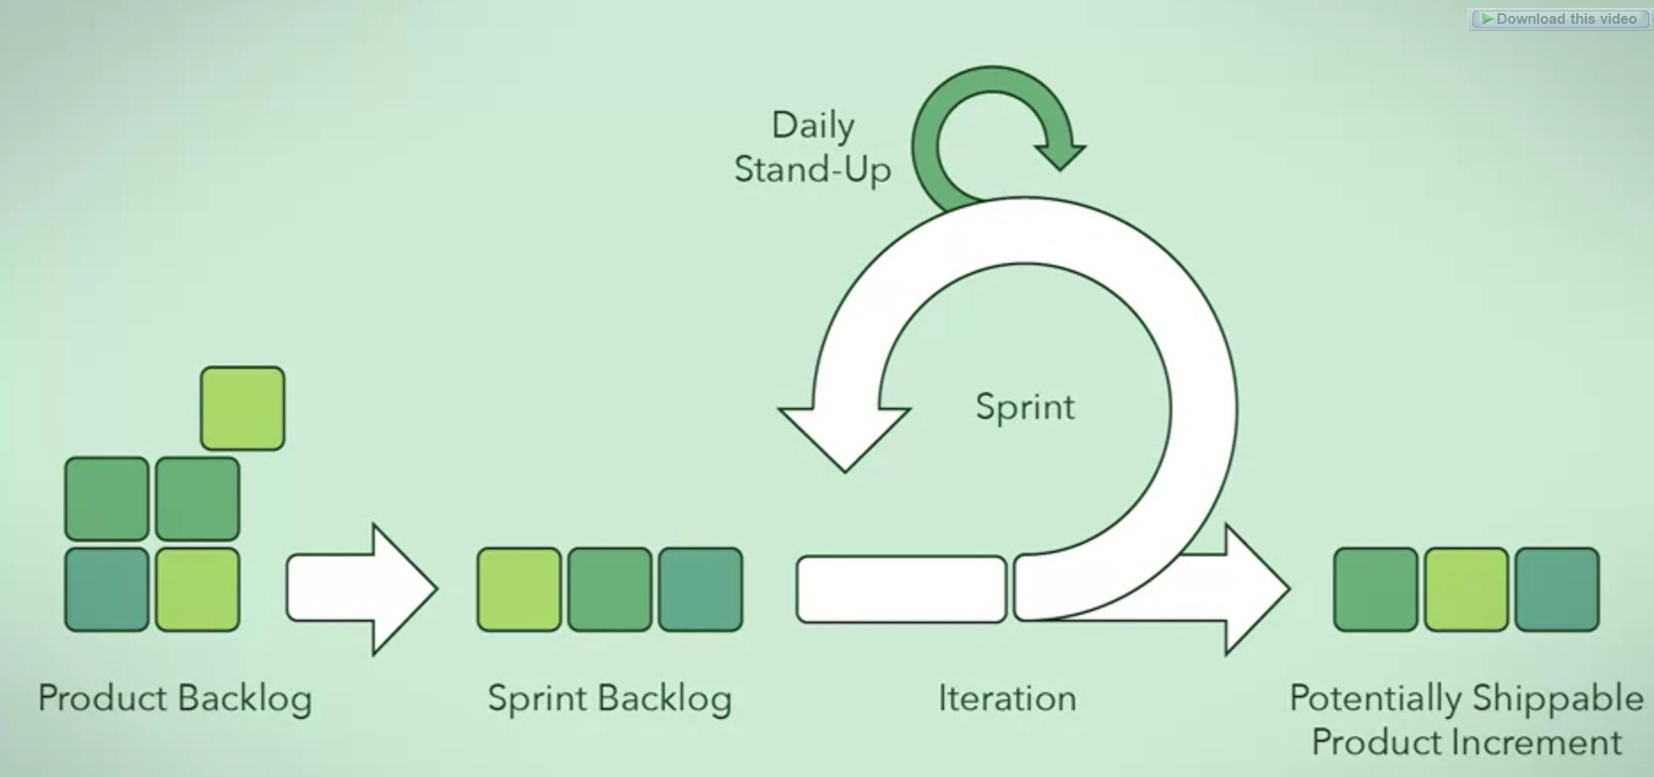
Software dev is an iterative process

Slide 8
Software dev is an iterative process
software development lifecycle is an iterative process because you take an item from the backlog and that item will have its own Sprint in that Sprint this feature will be implemented and then tested if it is shippable, you go ahead and ship it And pick up a new item from the backlog and start over but if it is not shippable then go ahead and fix the issues and test again and do this repeatedly until it is shippable.

Slide 9
Steps for setting up a design for a software
Gather requirements from the client and try to elicit them to come up with questions that the client might not have considered
Once you have a basic understanding of what the system is trying to accomplish you can go ahead and create the conceptual design
Then you can move to create the technical design diagram
So mainly it’s divided into 2 phases gather requirements and making the design

Slide 10
Software development phases
Eliciting requirements
Software design

Slide 11
Eliciting requirements
Begin by listening to what the client says and understands about what he wants to do
Ask more questions to understand more or to clarify some areas that might not be fully explained by the client (i.e., how the input should look like, how the output would look like, etc..)
You must ask the client about the trade-offs
NOTE: you can also write the requirements in a form that is more detailed and may contain technical details for Developers.

Slide 12
Software design
The design phase involving taking requirements and outlining solutions
This activity leads to producing a conceptual design and then a technical design
These 2 at the end produces 2 artifacts which are conceptual mock-ups and technical diagrams

Slide 13

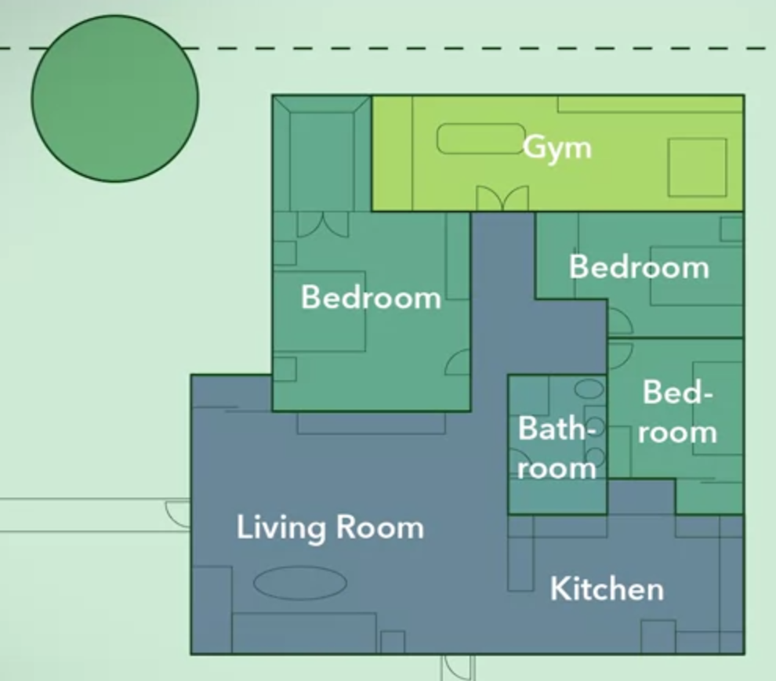
Conceptual design
You are working on a higher level and trying to find the different components in the system and how they interact with each other and the responsibility of each one, and you need to omit any technical details
For example, consider designing a house so the conceptual design for a house might be laying out the different rooms and where are they located and omitting the details about the exact size of each room in meters
Can be hand-drawn sketch or a drawing made using computer tools

Slide 14
Technical design
Start by defining the technical details of each component and this is done by dividing components into smaller and smaller components that are specific enough to be designed in detail
If your technical design fails to meet the requirements, you have it rework your conceptual design

Slide 15
Requirements Types
Functional Requirements
Non-Functional Requirements

Slide 16
Quality Attributes
First you have to define what type of requirements you are comparing the quality attributes for, for example for the functional requirements you might say correctness is not negotiable
Then for the non-functional requirements quality attributes you can negotiate on and see the consequences of each
After the implementation has been constructed the quality attributes must be reviewed and tested

Slide 17
Object oriented programming principles
1.Abstraction
2.Encapsulation
3.Decompostion
4.Generalization

Slide 18
Abstraction
Is simplifying concepts to its essentials within some context which allows you to focus on what’s important and ignore any unimportant details.

Slide 19
Encapsulation
1.bundle attributes and behaviors associated with this data
2.expose an interface to make the outer world deal with the object
3.restrict access to certain data and behaviors
NOTE: make the class a black box and this achieves reusability.
NOTE: it achieves Data Integrity through exposing an interface in which allowed data only are accepted
NOTE: Encapsulation allows us to apply Data Hiding

Slide 20
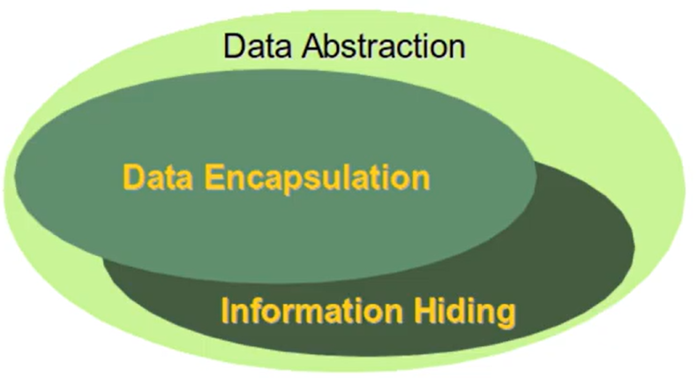
Abstraction and encapsulation

Slide 21
Decomposition
Taking a whole and dividing it into parts or on the flip side taking parts and combining them together to form a whole
It helps to divide a problem into subproblems that are easier to understand and solve

Slide 22
Decomposition
Sometimes the whole has a fixed number of parts such as the refrigerator has only 1 freezer in its entire lifetime. On the other hand, the freezer as the whole has a dynamic number of parts such as food that might change over time
Relations between these objects a whole and a part can be determined based on the lifetime of each one for example the whole and the part can exist without the other
Some parts also might be shared among other wholes

Slide 23
Types of decomposition
Association
Aggregation
Composition

Slide 24
Association
Is loose relationship between two objects that will interact with each other at some point of time but both objects can live without each other.

Slide 25
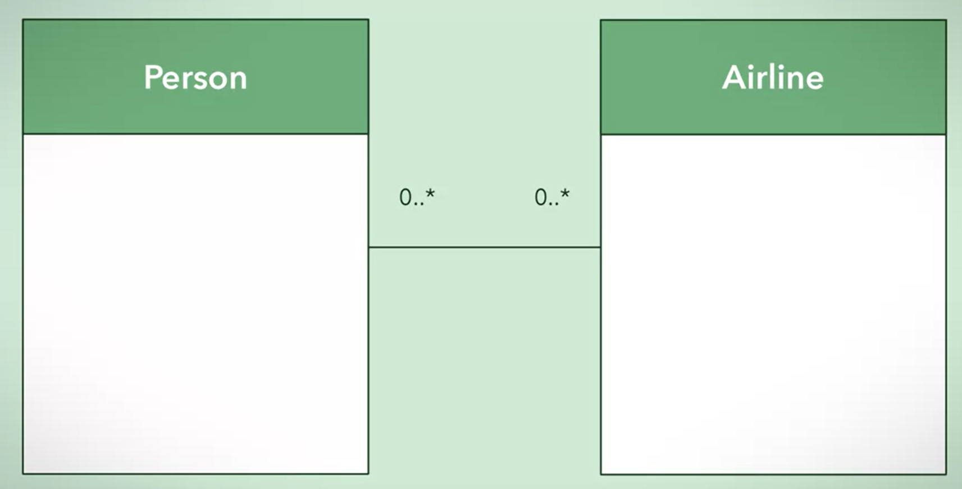
Association in UML

Slide 26
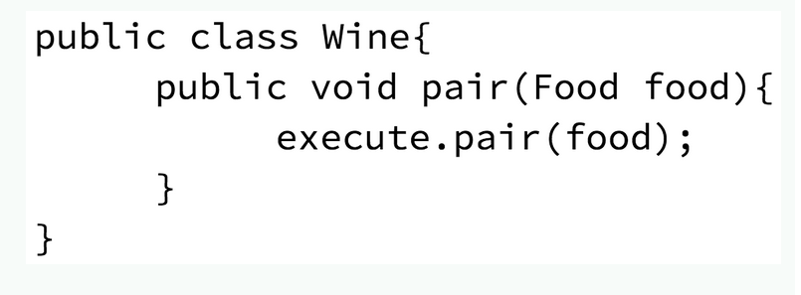
Association in Code

Slide 27
Aggregation
Is a “has a” relationship between a part and a whole but it’s considered weak because both part does not cease to exist without one another.

Slide 28
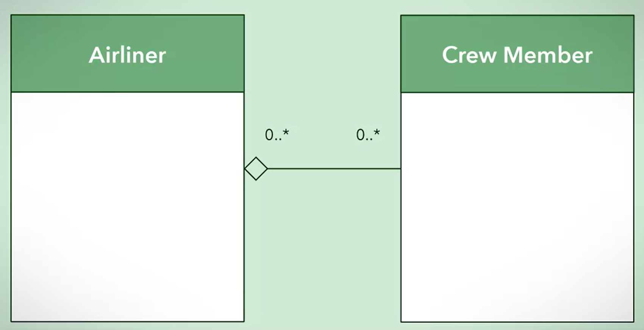
Aggregation in UML

Slide 29
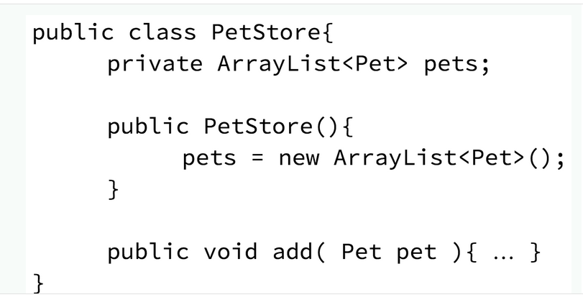
Aggregation in code

Slide 30
Composition
Is a strong “has a” relationship between a whole and its parts the whole cease to exist without the parts and vice versa.

Slide 31
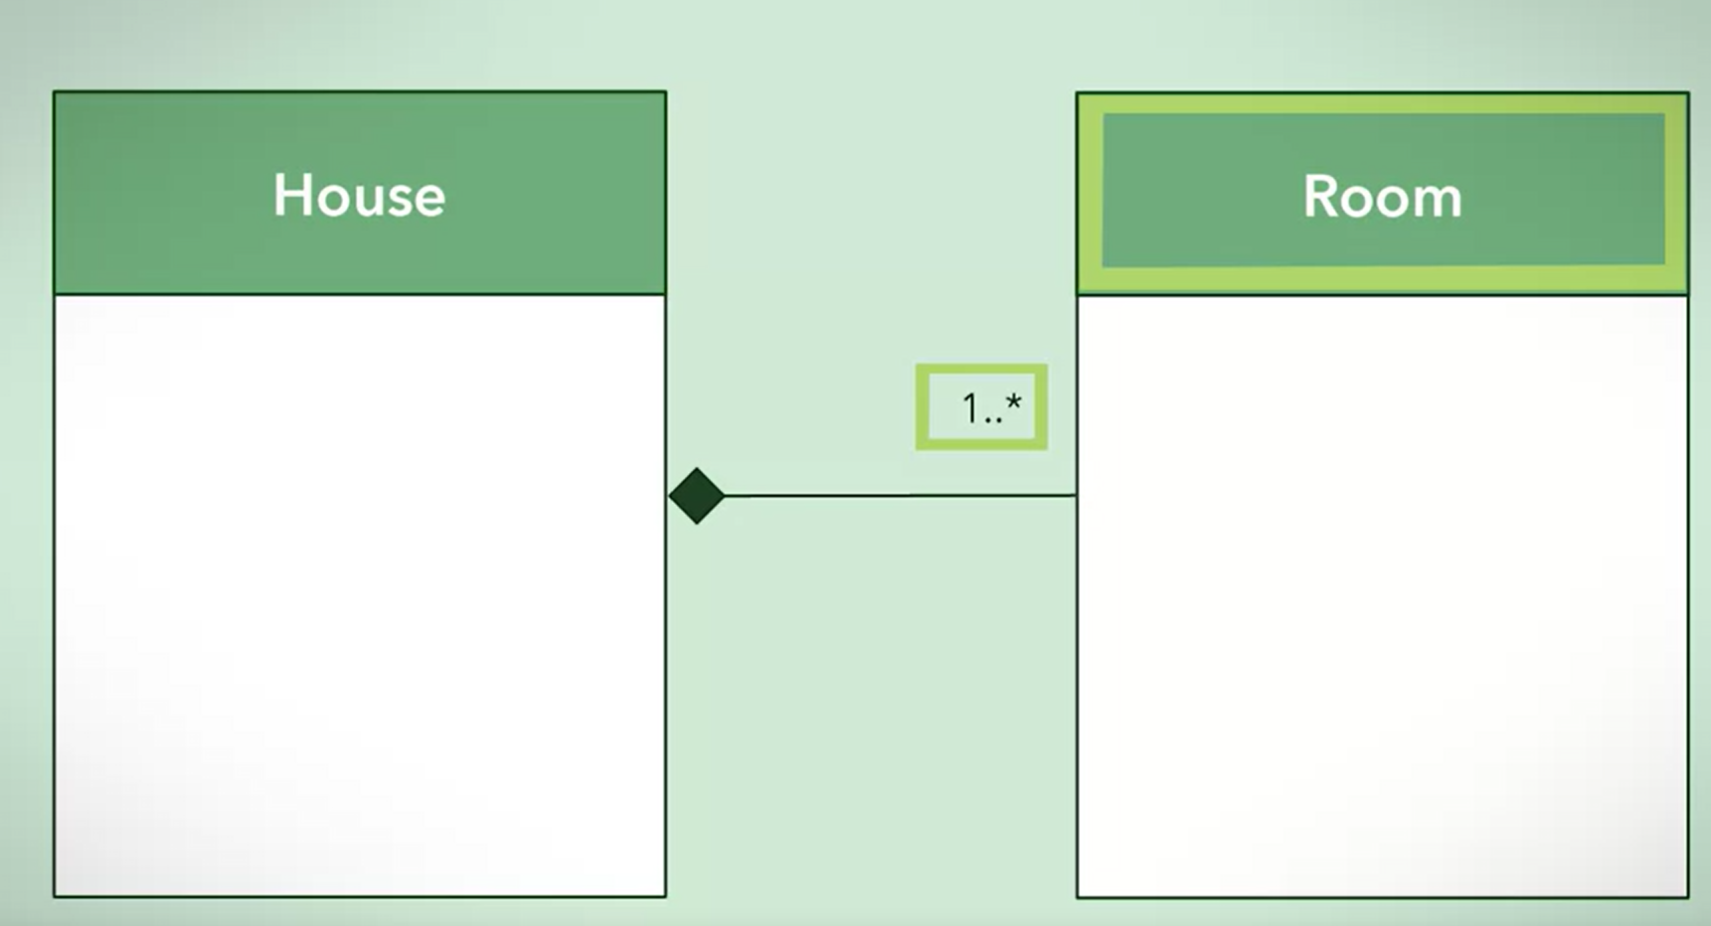
Composition in UML

Slide 32
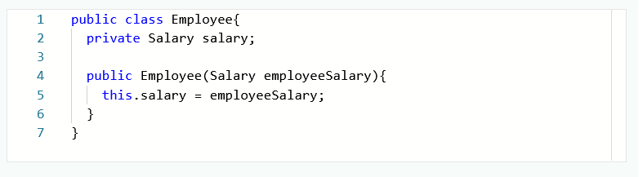
Composition in Code

Slide 33
Generalization
Can be achieved on the function level by making them have only one responsibility
It also can be achieved on the class level through inheritance by taking the common and shared characteristics among some classes and generalize them into one base class and make the specialized classes inherit from it
They are both used to achieve the D.R.Y principle which stands for Don’t Repeat Yourself

Slide 34
Evaluating your design complexity
This can be achieved through:
Coupling
Cohesion

Slide 35
Coupling
Focuses on the complexity between modules and other modules
NOTE: module here refers to methods and classes

Slide 36
Coupling
When evaluating the coupling of the modules of your system you need to think about 3 ideas:
Ease
Degree
Flexibility

Slide 37
Degree
Is the number of connections between a module and other modules
The less connections your modules have with each other the better your design become

Slide 38
Degree Examples
Keep the number of modules that you count on as low as possible
Make your functions take less arguments as possible as you could

Slide 39
Ease
The connections between modules should be obvious and clear so that there is no need to make predictions or to view the implementation of each module

Slide 40
Flexibility
Is how interchangeable the other modules are with your module
Code against abstractions not concrete implementations

Slide 41
Cohesion
Focuses on the complexity within a module and how clear the responsibility of a module

Slide 42
Software Design Principles
In general, these principles help us create software that is flexible, reusable and maintainable

Slide 43
Software Design Principles
Separation of Concerns

